Slide 1
Image Haze Removal Using Dark Channel Prior
M M Samar
Mtcn2020_06
Mtech CN

Slide 2
Dark Channel Prior Image Dehazing Technique

Slide 3
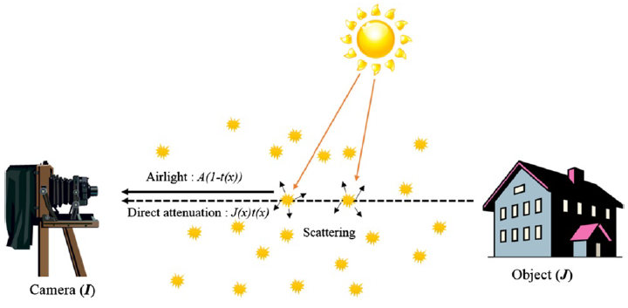
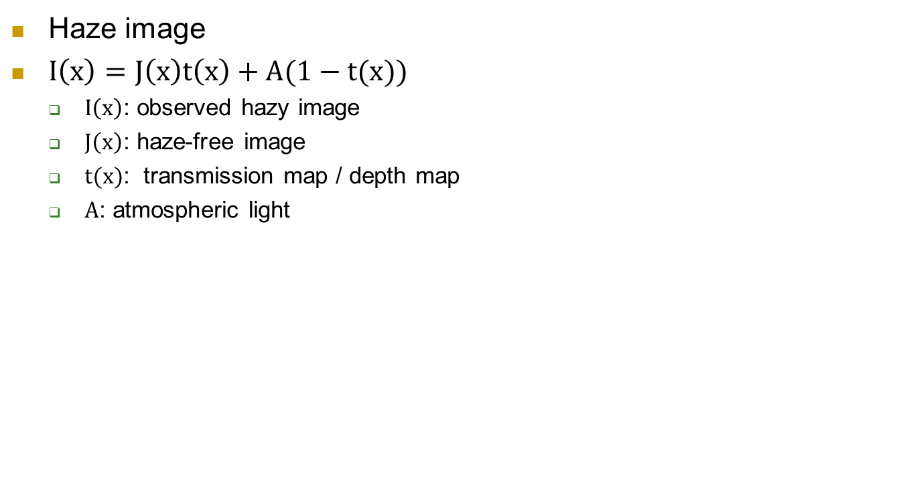
Degradation Model
Haze image
$I\left(x\right)=J\left(x\right)t\left(x\right)+A(1−t(x))$
$I\left(x\right)$: observed hazy image
$J\left(x\right)$: haze-free image
$t(x)$: transmission map / depth map
$A$: atmospheric light

Slide 4
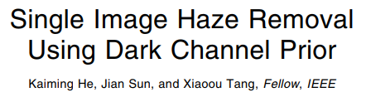
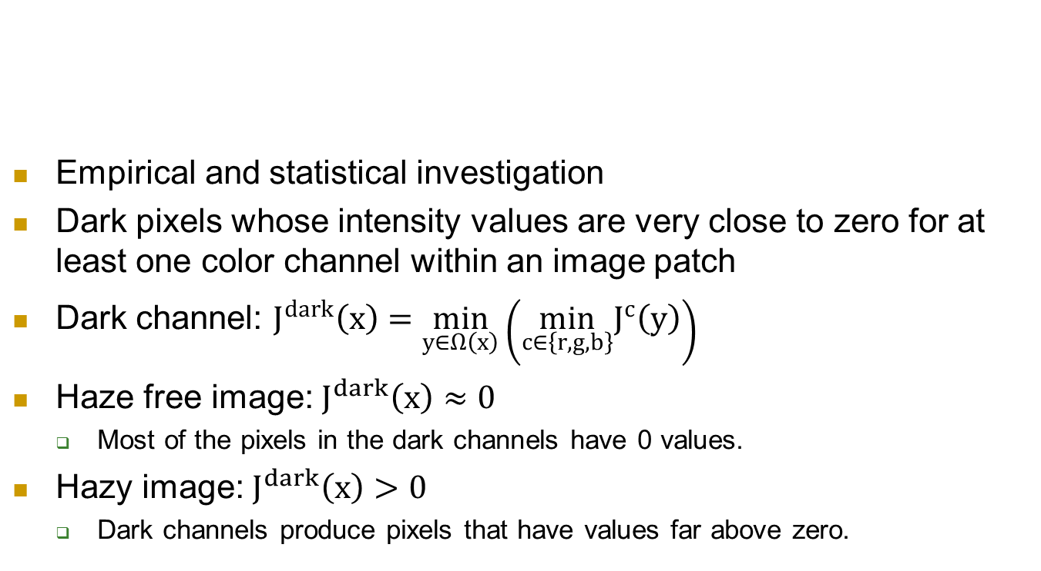
Dark Channel Prior (DCP)
Empirical and statistical investigation
Dark pixels whose intensity values are very close to zero for at least one color channel within an image patch
Dark channel: $J^{dark}\left(x\right)=\min_{y∈Ω\left(x\right)}\left(\min_{c∈\left\{r,g,b\right\}}J^{c}\left(y\right)\right)$
Haze free image: $J^{dark}\left(x\right)≈0$
Most of the pixels in the dark channels have 0 values.
Hazy image: $J^{dark}\left(x\right)>0$
Dark channels produce pixels that have values far above zero.

Slide 5
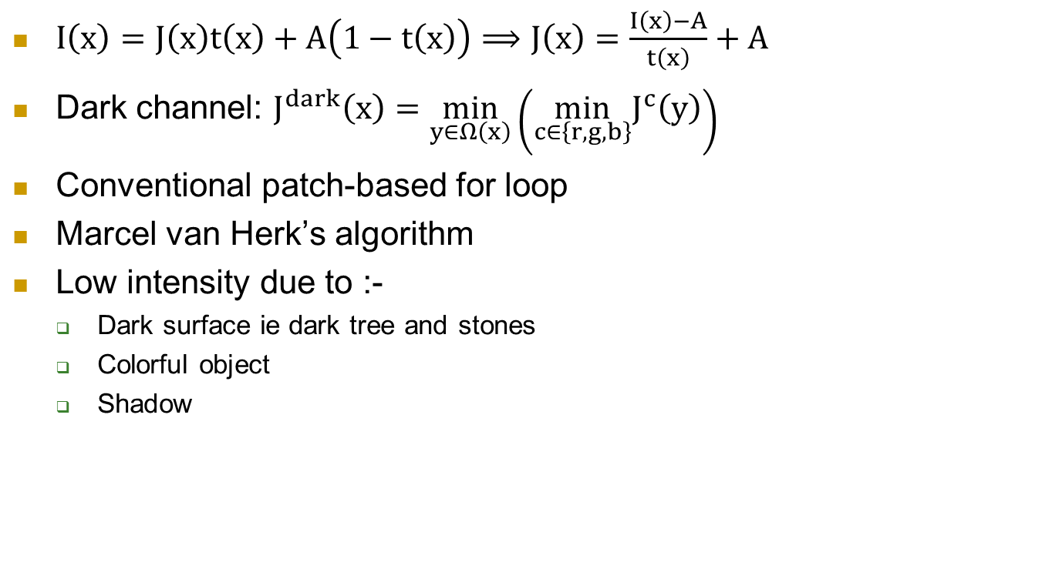
Dark Channel Construction
$I\left(x\right)=J\left(x\right)t\left(x\right)+A\left(1−t\left(x\right)\right)⟹J\left(x\right)=\frac{I\left(x\right)−A}{t\left(x\right)}+A$
Dark channel: $J^{dark}\left(x\right)=\min_{y∈Ω\left(x\right)}\left(\min_{c∈\left\{r,g,b\right\}}J^{c}\left(y\right)\right)$
Conventional patch-based for loop
Marcel van Herk’s algorithm
Low intensity due to :-
Dark surface ie dark tree and stones
Colorful object
Shadow

Slide 6
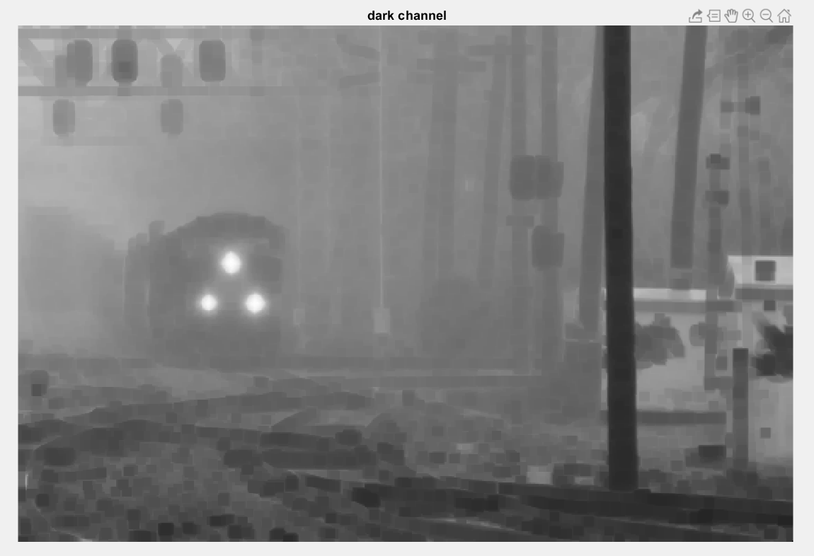
Dark Channel Construction

Slide 7

After Dark Method Result
$After apply Dark Method$
75% pixel Intensity is 0
Problem Exist
Dark Channel of Hazy Image Have Higher Intensity because of air light Intensity
Transmission is low

Slide 8
Atmospheric Light Estimation
The color of the atmospheric light is very close to sky
So just pick the first few pixels that are closest to 1 in Jdark
Pick top 0.1% brightest pixels in the dark channel

Slide 9
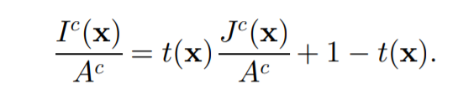
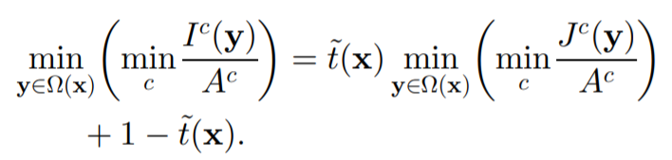
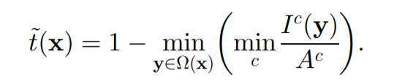
Transmission Map Estimation
Normalize Equation using Atmospheric Light And Apply JDark
Apply Dark channel on both side with min
Then Right Part=0
Final Equation be

Slide 10
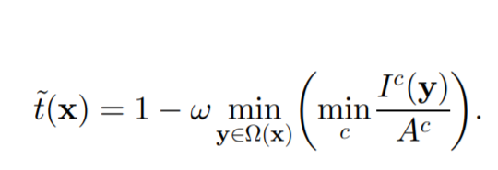
Transmission Map Estimation
But Color of sky =~Atmos Light, T(x)-->0
Keep small amount of haze Omega (0<omega<1)
Omega=0.95

Slide 11
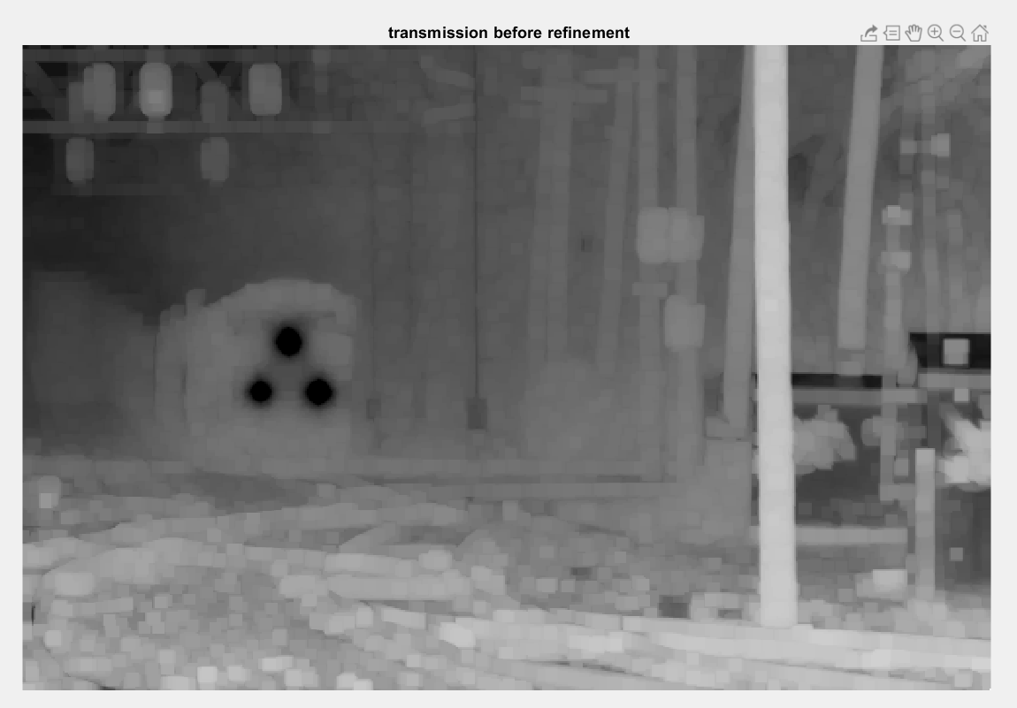

Slide 12


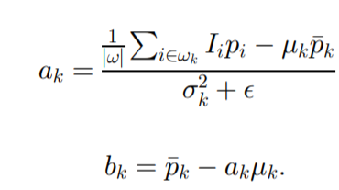
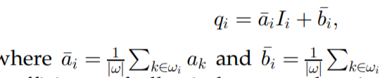
Transmission Map Refinement
Guided filtering formula
(a,b) coefficients
First Remove some Noise

Slide 13
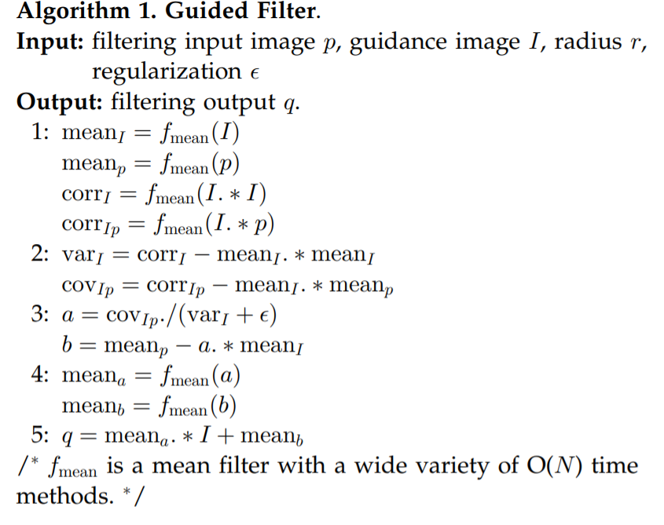
Transmission Map Refinement
Guided filtering

Slide 14
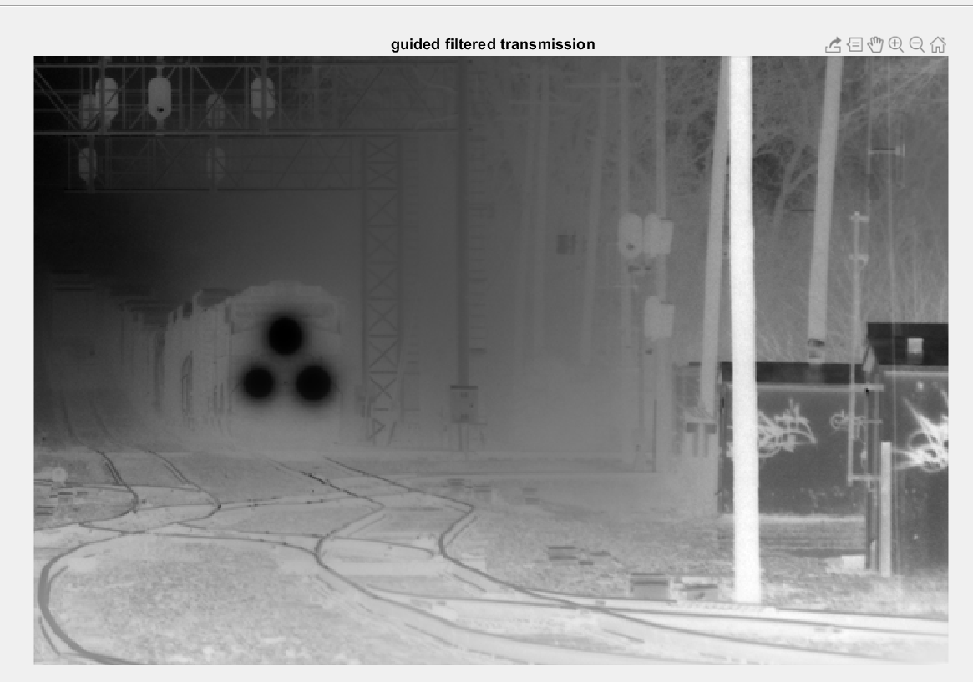
Transmission Map Refinement

Slide 15
Results Demonstration

Slide 16
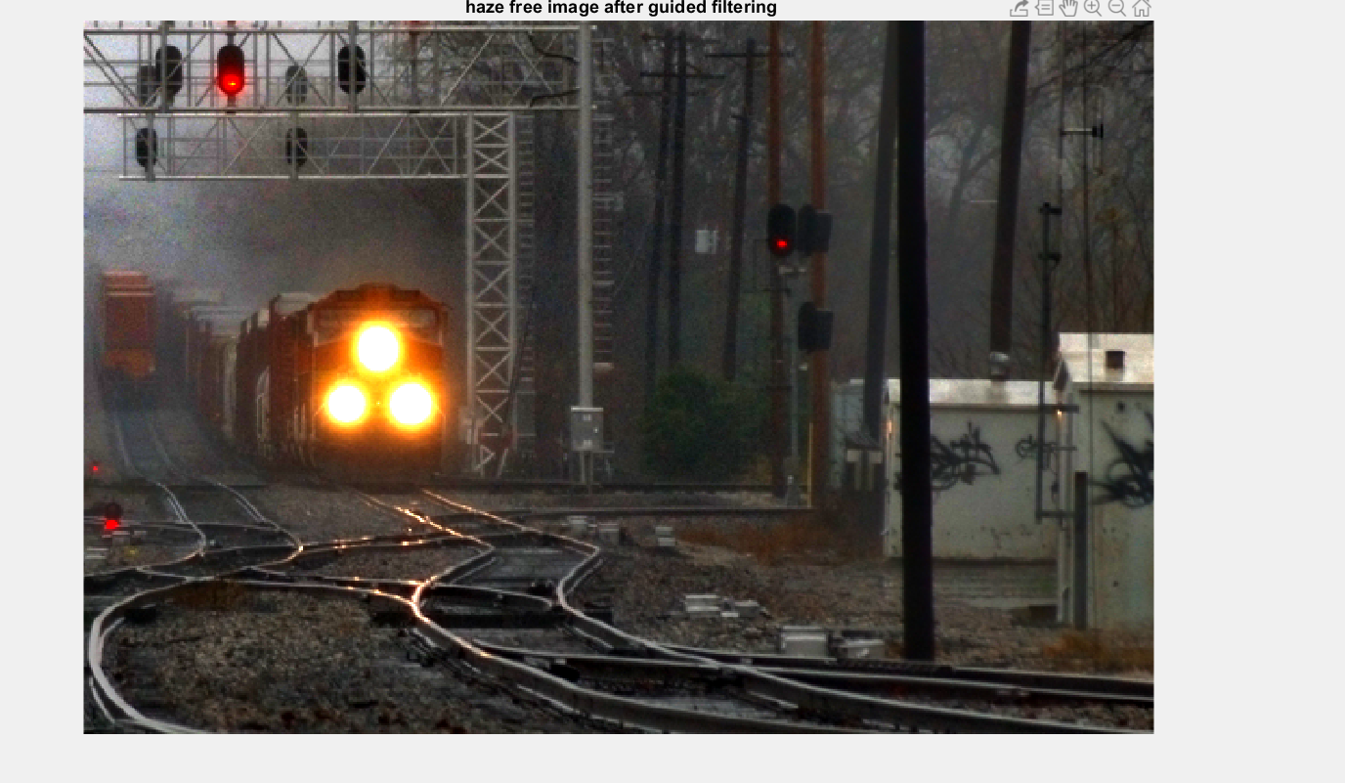

Slide 17
